Slide 1

Period End Closing Execution (BSC)
Period End Closing Process Overview
Period End Closing Overview
FCC Variants Overview

Slide 2
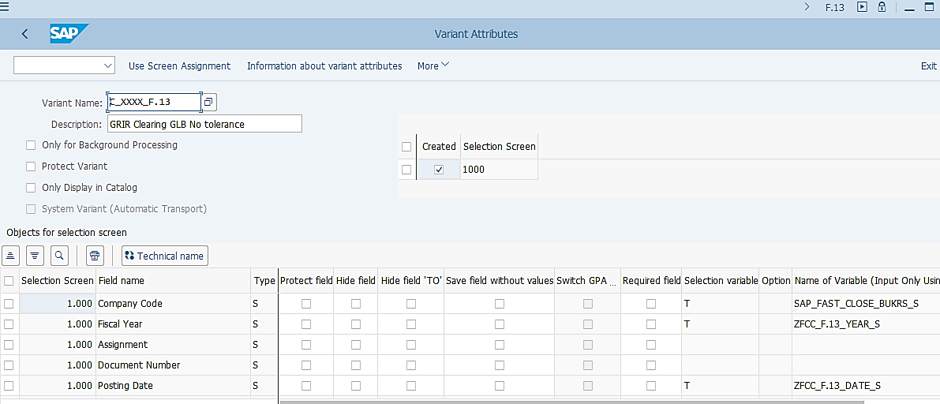
Basic Attributes of a Variant used in SAP
Variant attribute can be accessed via “Save as Variant” menu in a transaction. This is an example of a F.13 variant.
If a transaction is scheduled in an FCC task list as a Job, then the Variant Name to be used to run that job is maintained in the corresponding FCC task. You should be able to display the attributes of that variant via the respective end user transaction (e.g. F.13 in this example) as shown on this screenshot.
If the column “Selection variable” is indicated with “T” then a name of the variable needs to be specified here.
Some of the Variable Names begin with “SAP” and some begin with “ZFCC”. These are so called “Standard variables” and “Custom variables” respectively. These variables have to be defined first before they can be used in a variant. The next few slides explain how the variables and their values are defined.
These are the Field Names that are on the selection screen of the transaction.
If “T” is indicated in this column, it means that a Variable is used for this particular field. That means we need to specify a Name of Variable instead of indicating a specific value or a range. E.g. in this example, we have specified that we will use a Company Code variable, rather than indicating a specific company code or a range of company codes.
Most of the Variants used in FCC tasks use Variables in them. This allows the correct information to be automatically picked up when FCC tasks are run. However this also means when the transactions are executed outside of FCC using the same variants, some information need to be checked/corrected as you may see unexpected value populated due to the way how variables work. This will be explained further on the next slides.

Slide 3
Date/Period/Year and Company Code in Variants
The following two types of fields in FCC task variants use Variables frequently:
Date/Period/Year related fields
These variables are very widely used in fields representing date/period/year in variants
Examples of date/period/year in variants:
Posting Date / Posting Period / Fiscal Year
Reversal Date / Fiscal Year
Key Date
Company Code
Company Code variables are used mainly in variants which are used by all entities globally (“global variants”, e.g. “C_XXXX_F.13”) or entities belonging to the same GBS/JTBC (“GBS/JTBC variants”, e.g. “C_SPB*”).
The use of Company Code variables allows a single variant, instead of one per company code, to be created for use by multiple entities in the same FCC task, as long as other selection criteria are universal across all the selected entities.

Slide 4
Period End Closing Overview
Date/Period/Year in FCC Variants
FCC Variants Overview
Company Code in FCC Variants
Changing FCC Variants

Slide 5
How Are Date/Period/Year in Variants Defined?
Maintain values for Custom Variables in the Task List
2A
Creation of Periodic FCC Task List for a new period
Date/Period/Year in the Variants used in FCC tasks are populated automatically
1
3
Values of
Standard Variables auto-populated upon saving of Periodic Task List
2B

Slide 6
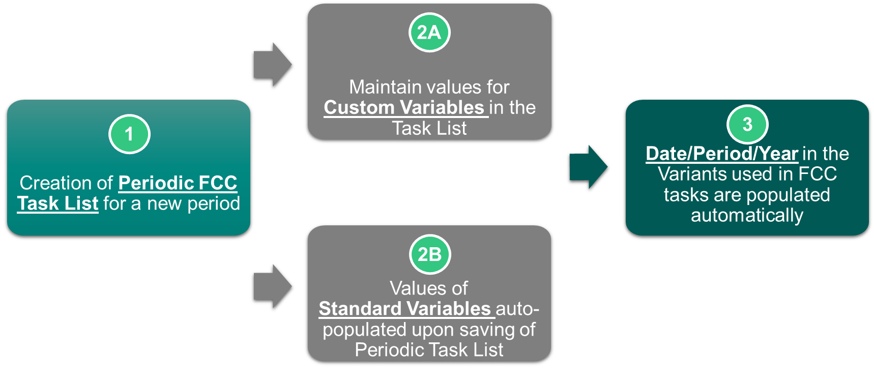
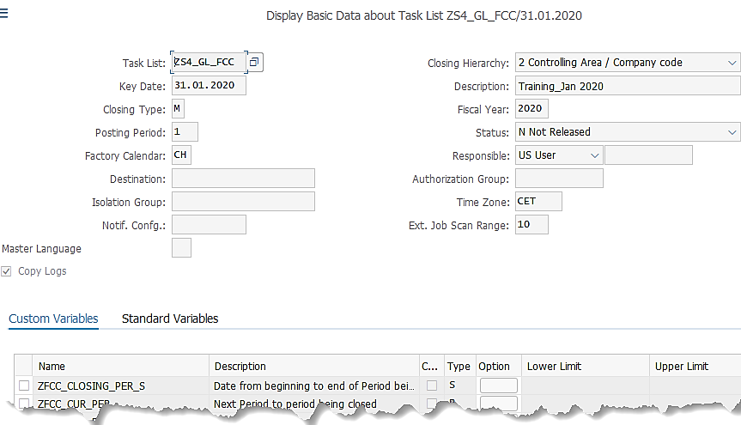

How Are Date/Period/Year in Variants Defined? 1. Creation of Periodic FCC Task List
How Are Date/Period/Year in Variants Defined?
Basic Data of new task list (centrally maintained by Warsaw)
1
When a new Periodic Task List is created, key information such as Key Date, Posting Period ad Fiscal Year values are inputted.
These values will help to define the values of both Custom Variables and Standard Variables used in the current period in the next step.

Slide 7
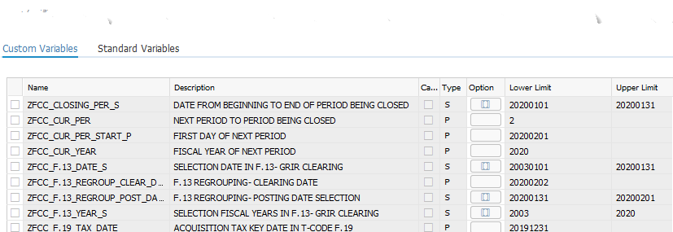
How Are Date/Period/Year in Variants Defined? 2A. Maintain Values for Custom Variables
How Are Date/Period/Year in Variants Defined?
Basic Data of new task list (centrally maintained by Warsaw)
2A
The values for Custom Variables must be updated manually when a new periodic task list is created.
The Name, Description and Type of each Custom Variable are already populated in every task list as per FCC configuration.
The Values of each Custom Variable will need to be inputted by the user. This is normally done by GBS Warsaw who creates new periodic task lists.
These dates/periods/years are extremely important as they determine the various dates/periods/years that will be used in the variants of FCC tasks when the system executes those tasks as per FCC scheduling.

Slide 8
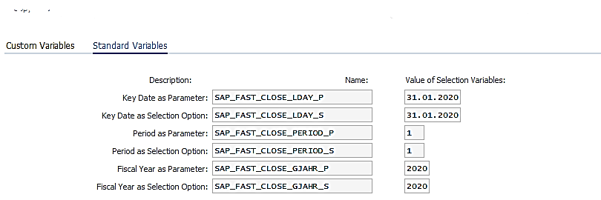
How Are Date/Period/Year in Variants Defined? 2B. Values of Standard Variables auto-populated
How Are Date/Period/Year in Variants Defined?
Basic Data of new task list (centrally maintained by Warsaw)
2B
When a new periodic task list is created, the Name and Description of each Standard Variable are already populated in every task list as per FCC configuration.
The Values are automatically populated based on the Key Date, Fiscal Year and Period information maintained in the task list when a newly created periodic task list is saved.

Slide 9
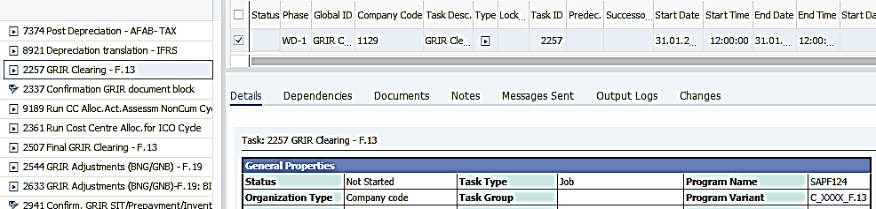
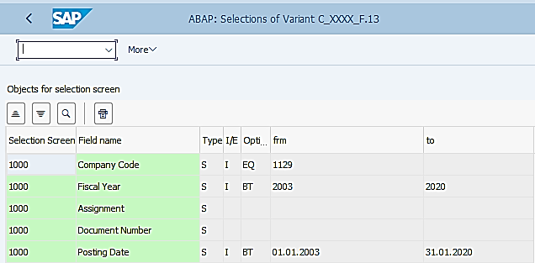
How Are Date/Period/Year in Variants Defined? 3. Date/Year in FCC task variants auto-populated
How Are Date/Period/Year in Variants Defined?
FCLOCO: FCC Task List -> select a task that uses a variant, e.g. F.13. Then click on the variant to see details.
3
As demonstrated earlier, once the Custom Variables and Standard Variables have their values updated within a FCC Task List, all the variants included in the jobs belonging to the specific task list should have the dates/periods/years related values updated.
This ensures that when executions of the jobs are triggered by FCC scheduling, they will pick up the correct dates/periods/years. ¹⁾
However, if you manually execute a transaction using the same variant, you may not always get the correct dates/periods/years. Please see next slide.
¹⁾ A task list will have to be released first (currently controlled by GBS Warsaw) before any tasks can be scheduled.

Slide 10
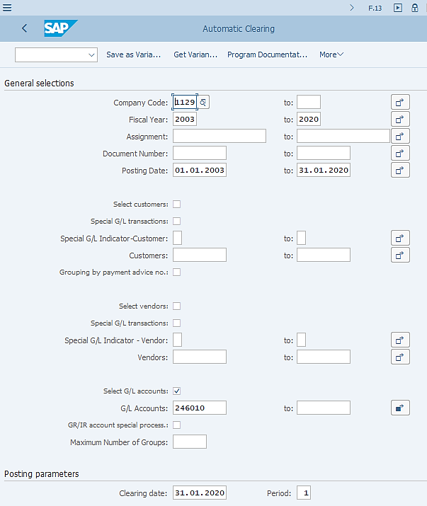
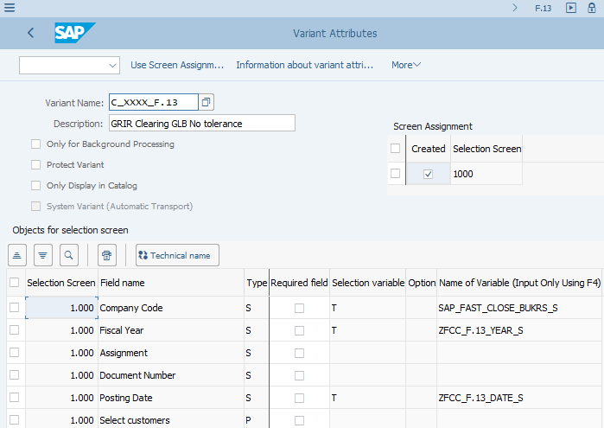
How Are Date/Period/Year in Variants Defined? When executing the transactions outside of FCC
F.13: Automatic Clearing ->Get Variant -> select the variant used in FCC task “C_XXXX_F.13”. Then follow “Save as Variant” menu to display Variant Attributes.
If you execute the period end GR/IR Clearing step outside of FCC for any reason, you will be able to see, from its Variant Attributes, that the dates/years selections are using the custom variables that were maintained in the current FCC task list.
So the question is “Are these dates/years correct?”
They will be correct only if you have the up-to-date FCC task list correctly maintained at the right timing, i.e. during the actual time frame when you are closing P1 2020, you have created the P1 2020 task list and updated the values of custom variables accordingly.
Other wise they will not be correct. E.g. (in testing environment) we are currently in April 2020 but there’s no P4 2020 task list created, instead the last task list available is P1 2020.
Due to the above reason, when you execute a transaction outside of FCC by using an FCC variant, you should always check the dates/periods/years and amend them if needed, e.g. if you are doing a testing for a specific month for which no task list is created.

Slide 11
Period End Closing Overview
Date/Period/Year in FCC Variants
FCC Variants Overview
Company Code in FCC Variants
Changing FCC Variants

Slide 12
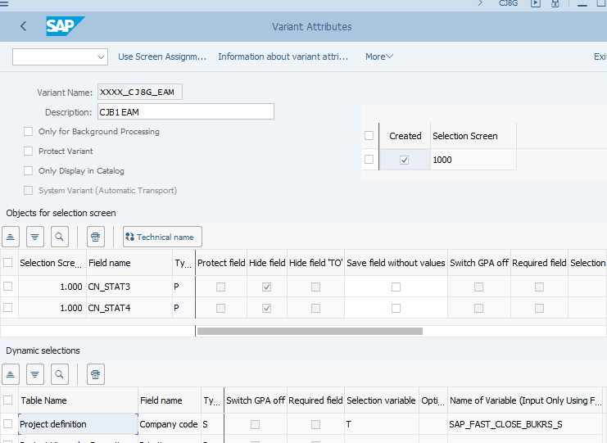
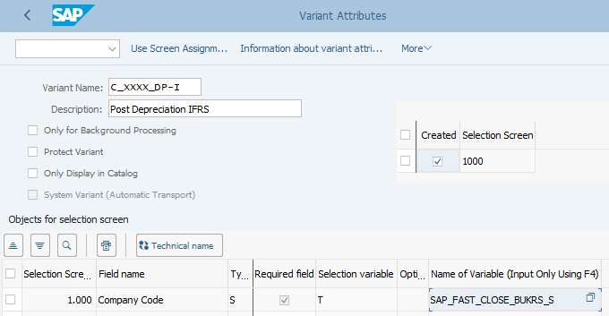
Variant Attribute for Company Code Field
Example of transaction using a “global variant” – AFAB (Depreciation Run) variant -> Click “Save as Variant” to access “Variant Attributes” as shown below.
Another example of “global variant” – this is not a variant for executing a transaction but a “Selection Variant” for CJ8G. Use “Change Variant” to access “Variant Attributes” as shown below
There are different ways how a variant is created with regards to the “Company Code” field selection.
In many cases (when a “global” or “GBS/JTBC” variant is not used), especially the transactions that are executed at entity level using a specifically defined variant just for a given entity, the Company Code is hard coded in the variant, which is very obvious and won’t go wrong whether you execute the transaction within FCC or outside of FCC. E.g. Revaluation and Translation variants.
In some cases, when a universal variant (or “global variant”), which is normally coded with “xxxx” in the variant name, or a variant containing all entities within a GBS/JTBC (“GBS/JTBC variant”) is used in an FCC task, you will notice in the variant attribute that the Company Code field selection is defined by Standard Variable SAP_FAST_CLOSE_BUKRS_S.
When a job task in FCC using standard variable SAP_FAST_CLOSE_BUKRS_S is executed within FCC, the correct Company Codes will be picked up depending on the setting of each FCC task, however if the task is executed outside of FCC, in majority of the cases the Company Code information will not be correct, therefore users are required to always review the Company Code selection when executing a task outside of FCC. See next slide for explanation.

Slide 13
How Are Company Codes in Variants Defined?
The way how standard variable SAP_FAST_CLOSE_BUKRS_S works is defined in customizing. This makes it convenient for FCC to automatically pick up the required company codes for a given task within an FCC Task List.
At the same time this might create some confusion if users execute a transaction outside of FCC using the same variant, as FCC folder settings are not taken into consideration if a transaction is executed outside of FCC, therefore the Company Codes populated from the variant may not be the correct ones.
Below shows the logic how an FCC task is able to pick up the correct company code. Examples are provided to demonstrate this logic on the following slides.
1
2
3
4
Each FCC task is assigned to a folder in an FCC Task List
Folders with tasks requiring Company Code uses Standard Variable SAP_FAST_CLOSE_BUKRS_S as Selection Variable
The values of company codes are marked as “+” or “-” to indicate which one is selected (“+”) for the FCC tasks within the folder
When an FCC task is executed via FCC the correct company codes are picked up based on the folder values

Slide 14
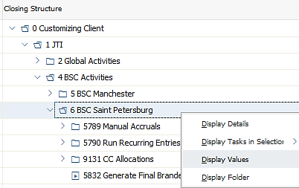
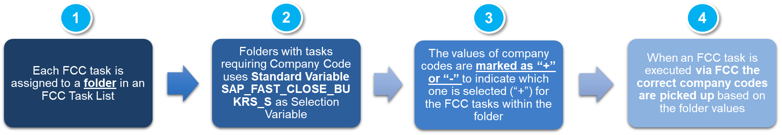
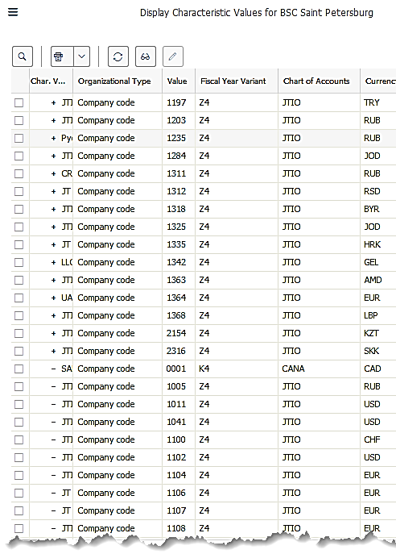
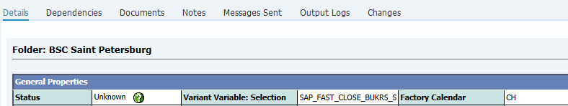
How Are Company Codes in Variants Defined? Company codes definition in each FCC folder
FCLOCO: Display FCC Task List ->Select folder for GBS/JTBC St. Pete GBS/JTBC level tasks -> Right mouse click
How does an FCC task pick up the required Company Codes?
1
3
These are Company Codes for GBS/JTBC St. Pete, which are marked with “+”.
2
These Company Codes do not belong to GBS/JTBC St. Pete, therefore marked with “-”.
Every folder would have the same list of Company Codes, which include ALL company codes in the system, even the ones which are not used/live. Then each Company Code is marked with a “+” or “-” to indicate whether they should be picked up by tasks belong to a given folder.

Slide 15
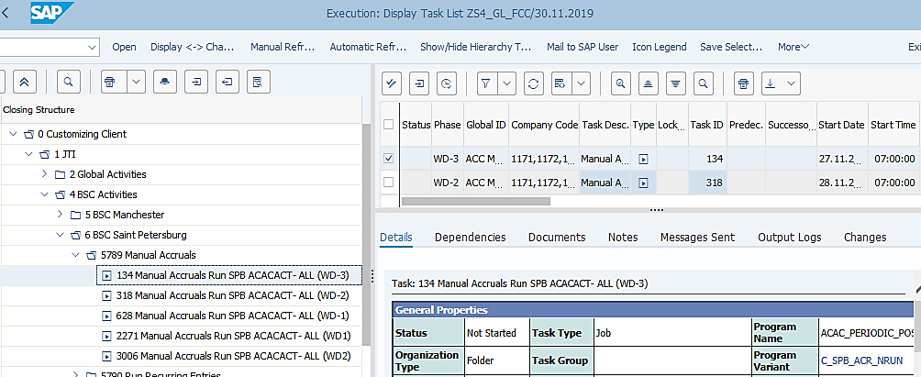
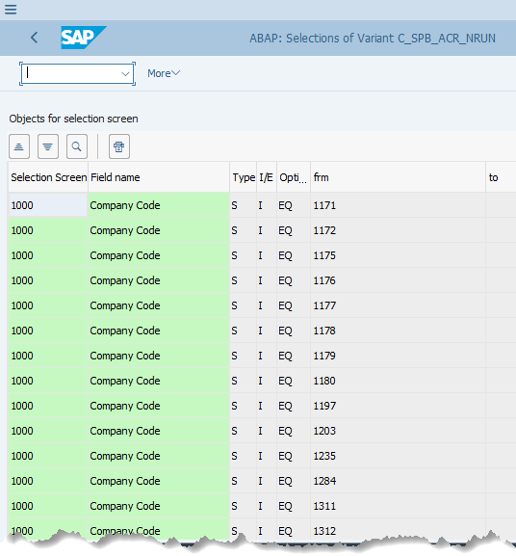
How Are Company Codes in Variants Defined? Company code values correctly picked up in FCC task variants (GBS/JTBC Variant example)
FCLOCO: FCC Task List -> select a Job task in the GBS/JTBC St. Pete GBS/JTBC level task folder, e.g. Accrual Run. Click on the variant to see details.
How does an FCC task pick up the required Company Codes?
4
As demonstrated, the company codes which were marked with “+” in the folder values customizing are automatically selected in the variant for the corresponding task.
There is nothing needs to be done from end user perspective, as long as the corresponding tasks are created in the correct folders.
This also means when a new company code should be added or removed permanently (not temporarily or in one-off occasion), the folder customizing (instead of the specific variant in question) will need to be updated by BTS. This is done via a Change Request when such business requirements occur.

Slide 16
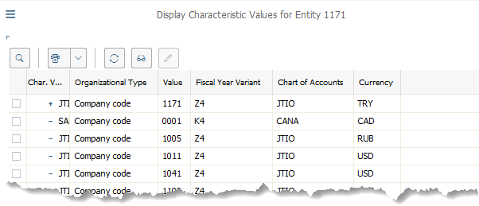
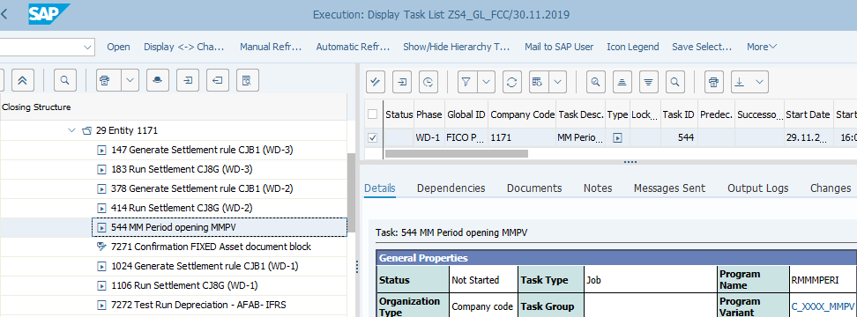
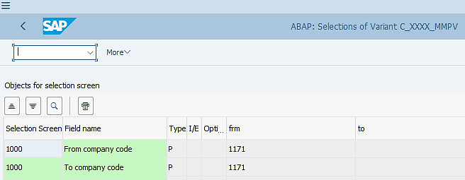
How Are Company Codes in Variants Defined? Company code values correctly picked up in FCC task variants (Global variant example)
FCLOCO: FCC Task List -> select a Job task in an entity task folder, e.g. 1171. Select a task in this folder, e.g. MMPV. Then click on the variant.
Right mouse click of 1171 folder and choose “Display Values”
In this example we are looking at a task in an entity task folder. In an entity task folder only the respective company code is marked with “+”, which allows only this one entity to be selected during FCC task execution.
If you have a new company code to be added to FCC, the corresponding entity task folder will also be added and configured in the same way as demonstrated. Again this is done by BTS via a Change Request.

Slide 17
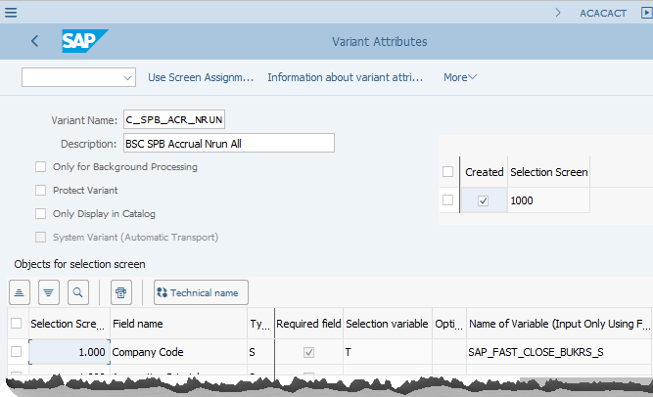
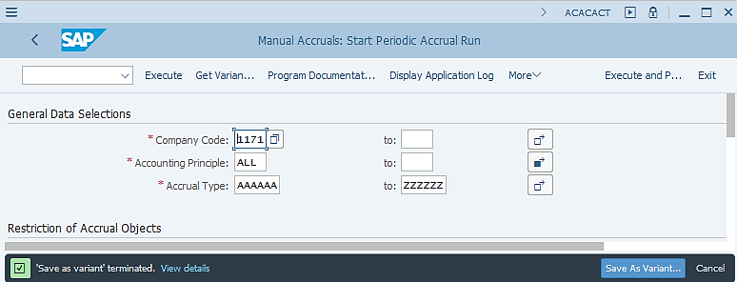
How Are Company Codes in Variants Defined? When executing the transactions outside of FCC
ACACACT: Monthly Accrual Run ->Get Variant -> select the variant used in FCC task “C_SPB_ACR_NRUN”
If you execute the ACACACT step outside of FCC for any reason, you will be able to see, from its Variant Attributes, that the value for Company Code field selection is incorrect. I.e. all GBS St. Pete company codes should be selected as we saw on the screenshot of FCC variant details, but now there’s only one selected on the screenshot. Also, different company codes may be shown on different users’ computers when calling the same variant outside of FCC.
This is due to the fact that standard variable SAP_FASF_CLOSE_BUKRS_S is not able to refer to any folder in FCC when you execute the transaction outside of FCC. It then picks up the latest company code that you recently used in execution of an SAP T-Code.
For this reason, when you execute a transaction outside of FCC for any reason, make sure you double check the Company Code selection to ensure it is correct before executing.

Slide 18
Period End Closing Overview
Date/Period/Year in FCC Variants
FCC Variants Overview
Company Code in FCC Variants
Changing FCC Variants

Slide 19
Changing FCC Variants – What Shall I Do?
Why?
Change a variant used in FCC for temporary execution
Change a variant used in FCC for permanent use
When?
This could be for testing purpose
This could be a one-off execution during real period end driven by any issue which requires changes, e.g. a company code or G/L account should be excluded
This could be a temporary execution before the change request of changing FCC tasks have been implemented
This is when business requirements change, e.g.
When you need to add or remove company code(s) from your variants due to change of the company codes that your GBS/JTBC is serving
When some accounts need to be included/excluded from the variants due to change in accounting treatment
What to do?
You can “get” the variant used in FCC task, make the required changes and execute the transaction without saving it.
If you wish to save it, make sure you save it under a separate variant name that describes the purpose and usage of it.
BTS will implement the changes of adding/removing company codes in customizing within your change request for your new business requirements. There’s no change to be done on user side.
The exception for this is for the company code specific variants, e.g. Revaluation, GBS/JTBC should align with BTS to create the new variant for the new entity based on its specifications.
Other than Company code field, for global/GBS/JTBC variant, any change (e.g. accounts, ticks of different options, etc.) should be agreed across GBS/JTBC before one of the GBS/JTBC makes changes. Once a change is made, GBS/JTBC should save the variant to the existing variant name overwriting it.

